Slide 1
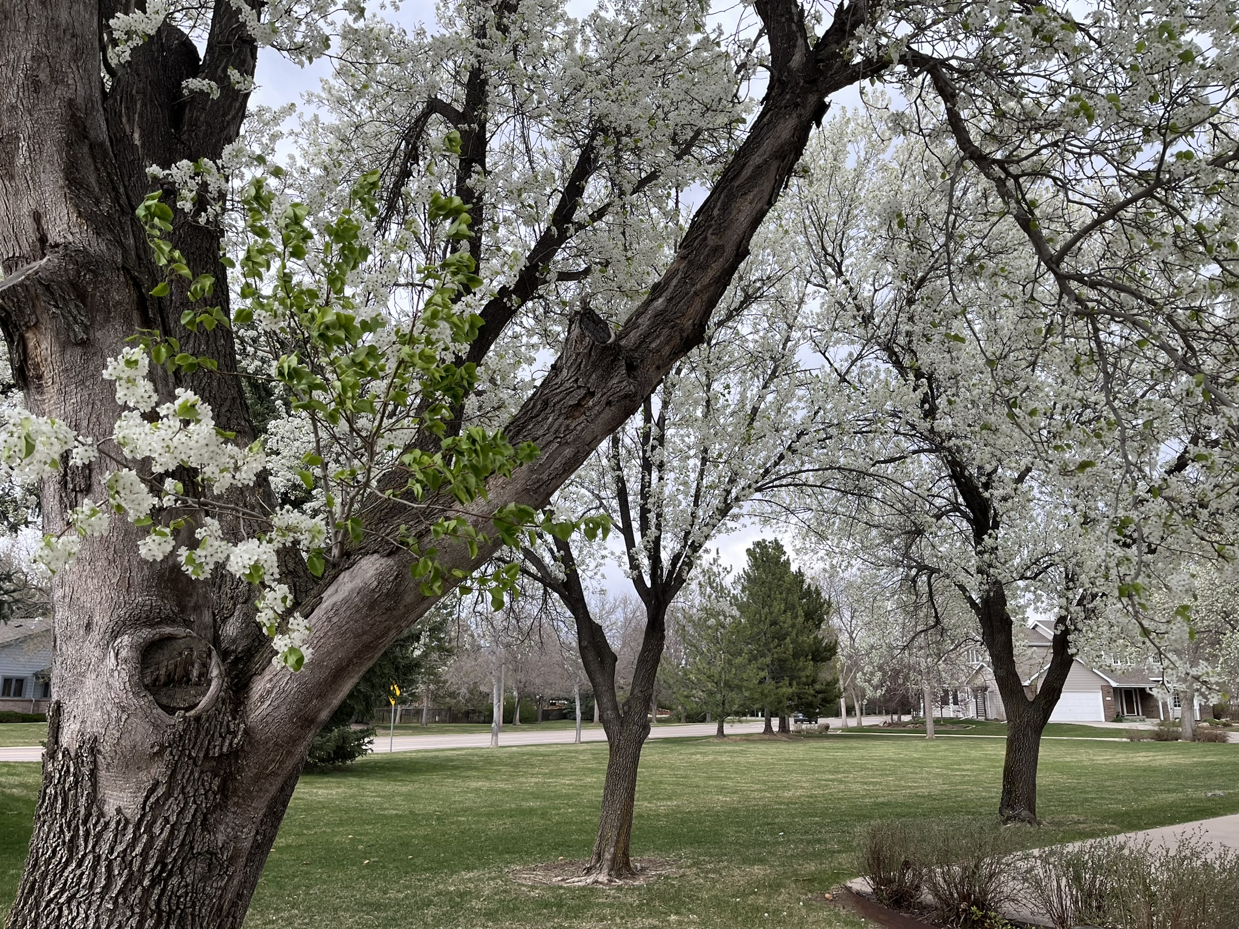
Oak Ridge Village I HOA
2024 Director’s Report
3-11-25

Slide 2
2024 Accomplishments
Implemented formalized accounting protocols & migrated historical records into Quicken
Aligned HOA with tax filing requirements; 2023 federal & state tax forms completed by CPA
Continued efforts to digitize records
Trash services negotiated
Completed policies assessment; updated policies complete and ready for transparency review and execution in March
Amended and restated Bylaws completed by attorney, ready for review and execution by April
Attorney drafting Declaration of Covenants expected for board review late March; target first homeowner review April and vote in May
HOA website implemented

Slide 3

2024 – General Board Updates
Minimal ACC requests
Community Canopy Program
No unusual maintenance costs
Unexpected legal fees
Maintained HOA in good standing (Sec of State; DRE)
Community Event (Though ultimately, canceled, thank you Kathy for securing grant & coordinating)

Slide 4
Board Priorities – Legal & Compliance
2024 federal & state tax filings by 4/15
Finalize legal documents by May
Policies March; Bylaws April; Declaration of Covenants May
Landscaping policy
Including 3 required pre-approved gardens
Rules & regulations
Reserve study
Pending since 2016; complete every 5 years
Explore CCIOA (Colorado Common Interest Ownership Act) adoption
Notes:
CCIOA voluntary adoption: Even if exempt an HOA can choose to adopt CCIOA to ensure consistent management practices and provide greater legal protections for both the association and unit owners
By adopting CCIOA an exempt HOA gains access to a structured framework for managing the community, including rules around assessments, dispute resolution, and financial transparency
To adopt CCIOA, the HOA board must pass a resolution recommending the adoption and then present the decision to unit owners for a vote

Slide 5
Board Priorities – Governance
Complete landscaping associated with capital assessment
Board governance guide (aka operating manual; draft complete, requesting review volunteers from prior board directors)
Insurance assessment
Formally close out open interpretation of HOA scope of responsibility (boundaries; community area maintenance)
Summer community engagement event

Slide 6
Old Business
Governing Documents
Policies (compliance) – COMPLETE
  9 total (4 revised, 1 new, 4 updated)
  Legal standards; transparency review for members with 7-day period for comments before board vote to adopt
Bylaws (govern how the HOA operates) – Amended & Restated COMPLETE
  Distribution to homeowners including 14-day period for review and comments; vote with 30-day notice
  Boilerplate to CO legal standards with 1 item for review: Quorum 2.8 (standard 15%, board recommends increase to 25% upper recommended threshold, given size)
Declaration of Covenants, Conditions & Restrictions (CC&Rs explain the rules of the HOA) – MAY
  In development by attorney; board expects initial draft EOM March with Member review in April; vote in May with appropriate notice
  To address Member concerns, board collaborating with attorney to define reasonable timeline terms for completing approved ACC requests – open to additional input as CC&Rs routed for input and vote
  Colorado law is 67% approval vote to pass; law supersedes current 75% amendment term
Rules & Regulations – JUNE
  Clarifies broader rules from CC&Rs
  Easier to adapt but cannot introduce new restrictive elements not included in CC&Rs
    Example: CC&Rs state “first class or superior materials”; rules & regs defines that meaning (cedar fence; class 4 IR shingles architectural style)
    Example: CC&Rs state fences must be approved; rules & regs consults city ordinance, community aesthetics and further defines material (cedar), height, style
  Updated ACC request form in development; expected in spring (online & paper)
Tax Filing

Slide 7
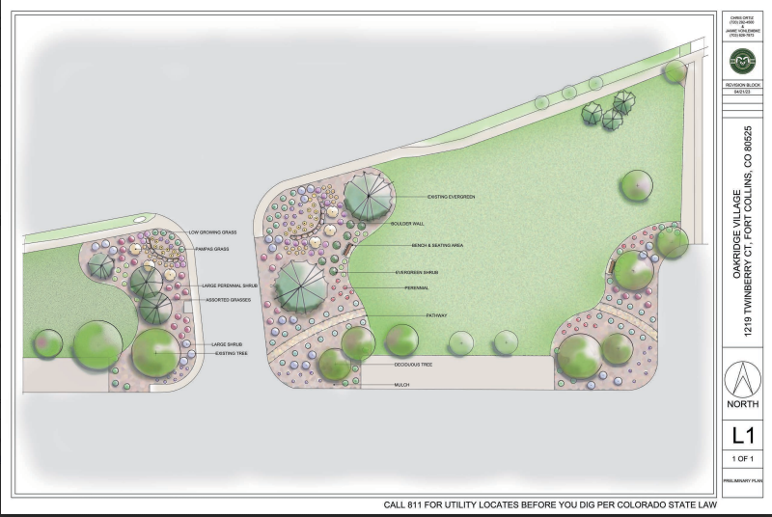
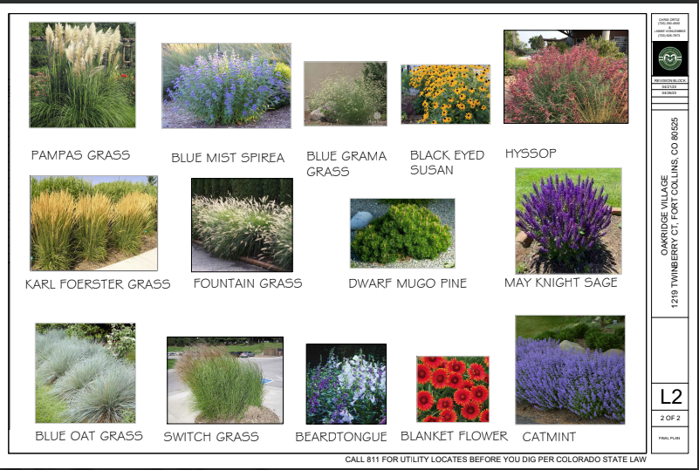
Landscape Update
Met with Fort Collins XIP Department
Offer up to $15K in matching funds for projects like this
  Currently, the Commercial program is not competitive and funds are available.
  Discussed other available grants.
Had ideas regarding the plan and irrigation.
  XIP Dept working on estimated water savings as well as estimated funds for our project.
  Concerns over increased maintenance costs with the volume of perennials.
Depending on funding, we may want to break the project up into at least two phases.
Next Up
Bids from landscape companies

Slide 8
New Business
Website is up – some elements remain under construction
  Oakridge1hoa.org
  Funded as a gift through 2026
Spring clean up
  Weather dependent: Propose April 26, with May 17 (backup)
  Volunteer to assess needs, coordinate?
Board governing guide
  Operating manual with clear tactical guidelines on what HOA board is responsible for; soliciting volunteers to review, preferably prior board directors (last 10 years) who would identify anything missing
Reserve study – Policy implemented 2016; overdue for study. Seeking volunteers to partner with BOD
Communication with board
  BOD.oakridge1hoa@gmail.com
  ACC.oakridge1hoagmail.com
  Officer addresses (president.oakridge1hoa@gmail.com, vp.oakridge1hoa@gmail.com, secretary.oakridge1hoa@gmail.com, treasurer.oakridge1hoa@gmail.com)
  In support of transparency, records retention & timely responses, use only the above Oak Ridge HOA gmail addresses; please refrain from personal email or texting, etc.
Budget & Dues
City Canopy Program

