Slide 1
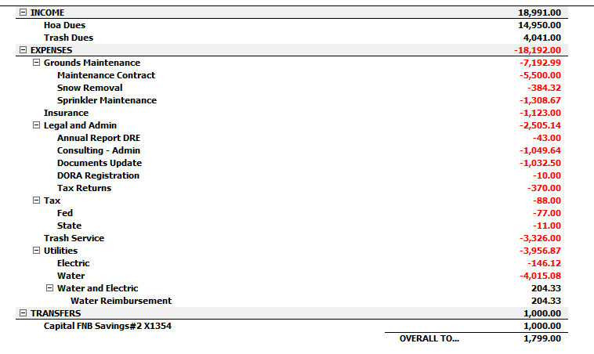
Net Cash Flow Checking Account 2024
Trash expense does not include Feb and Mar at $357.50. Total = $3326 + $357.5 + $357.5 = $4,041
Dues collected were 13 * $1150 = $14,950

Slide 2
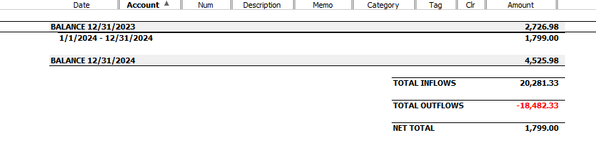
Checking Beginning & Ending Balances

Slide 3
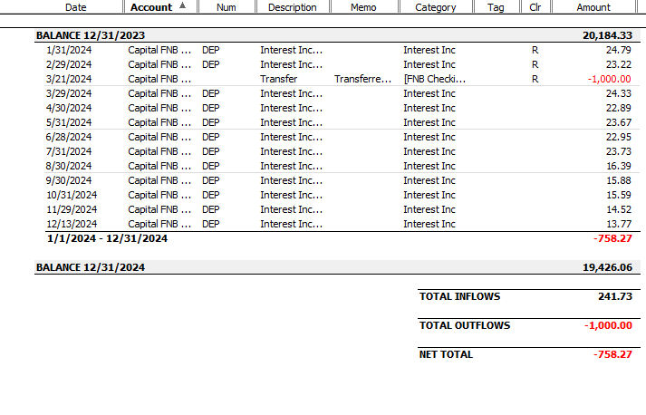
Capital Account Transactions and Balances

Slide 4
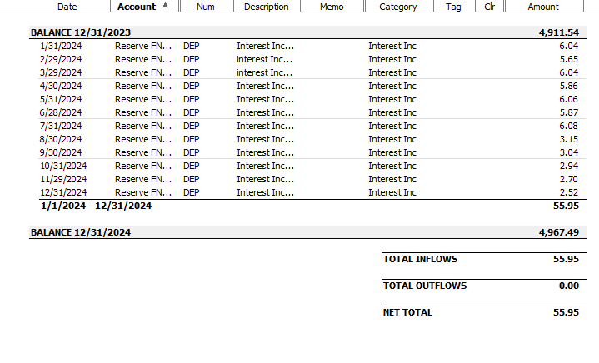
Reserve Account Transactions and Balances

Slide 5
2025 Landscape Maintenance and Snow Removal
Current contract covers landscape maintenance thru 2025 and snow removal thru May 1, 2025.
  Landscape maintenance $5610.00 a $110 increase from 2024.
  No change in sprinkler repair rates.
  No change in snow removal rates.
We will need new contract to cover snow removal for fall and 2025 and for snow and landscape maintenance 2026 and beyond
Notes:
We renewed out contract with Evergreen both landscape maintenance and snow removal for the next 2 years.
I started the process of requesting competitive bids but in consultation with the board we decided to accept Evergreen’s proposal once we saw it. I contacted 2 contractors and the first did not acknowledge my request for a bid and the second did not respond before we made a decision to go with Evergreen.
We had a number of reasons for not seeking competitive bids.
In spite of inflation the increase in maintenance cost with very small and there was no increase the second year.
Snow removal charges are based on actual time spent and method of snow removal. Larger equipment costs more. The contracted rates for snow removal are the same as the last 3 year contract.
We’ve used Evergreen for more than 20 years and they’ve always provided the lowest cost proposal.
We aren’t planning any changes to the landscaping that would impact 2022 maintenance , but changes to following year might have significant impacts. We need to work with a contractor with whom we have experience and a good working relationship.

Slide 6
Trash Summary
No increase in RAM waste rates until Oct 2025 at earliest.
Rates not dependent on recycle cart size or yard waste opt out.
Notify RAM waste and Katie with any changes to your service level

Slide 7
Trash Rates 1st Half 2025
Rates not dependent on recycle cart size or yard waste opt out
Trash cart size | City Contract Rate | 2025 1st Half Rate
95 gallon | $55.10 | $41.25
65 gallon | $37.10 | $27.50
35 gallon | $19.10 | $13.75

Slide 8
10-Year Water Usage Trend

Slide 9
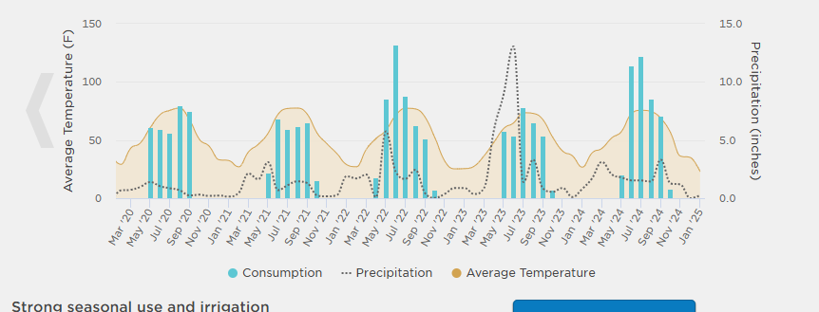
5-Year Irrigation Trend

Slide 10
2025 Budget vs 2024 & Proposed Dues
CATEGORY | 2024 Budget notes | 2025 Budget | 2024 Actual | 2024 Budget
Annual Report | Included with legal
Backflow Test | Included with sprinkler repair
Landscape & cleanup homeowners | 5 yr avg |  |  | $25.39
Cleanup tree branches contracted | 10 yr avg |  |  | $252.43
Electric | 12 x Jan 2024 actual of $13.02 | $156.24 | $146.12 | $146.04
Landscape & irrigation maintenance | Contracted price w provider | $5,610.00 | $5,500.00 | $5,500.00
Insurance | Actual paid Jan 2025 | $1,285.00 | $1,123.00 | $1,123.00
Landscaping Improvements | Use Capital Account***
Legal And Consulting Costs | Docs update, consulting | $2,500.00 | $2,505.14 | $3,053.00
Misc HOA Expense
Infrastructure repair/replace | Use Reserve Account
Snow Removal | 3-year average | $668.11 | $384.32 | $758.33
Sprinkler repair & maintenance | 5-year avg + backflow test | $932.08 | $1,308.67 | $804.40
Trash Service | Removed from budget calc 2024
Tree Costs Contracted (spray, prune) | No planned spraying or pruning
Tax State and Federal |  | $100.00 | $88.00
Water | 3-year avg | $3,681.05 | $4,015.08 | $3,343.58
 | TOTAL w/out Trash | $14,932.48 | $15,070.33 | $15,006.17
 | Per Home Expense w/out Trash | $1,148.65 | $1,154.32 | $855.74
 | Proposed Dues | $1,150.00 | $1,150.00
Reconciled to Quicken Expense of : $15070.33 + $3326 (trash paid) - $204.33 = $18192.0

Slide 11
2025 Dues Payment Amount and Schedule
 | Dues at $1150
2024 Trash | Trash Apr thru Sept | 1st Pmt | 2nd Pmt | Trash Oct thru March | Total
35 gal trash cart | $82.50 | $616.25 | $616.25 |  | $1,232.50
68 gal trash cart | $165.00 | $657.50 | $657.50 |  | $1,315.00
95 gal trash cart | $249.00 | $699.50 | $699.50 |  | $1,399.00
Does not include 2nd half trash which is TBD
Entire payment due April 15 or
1st payment April 1 & 2nd payment June 1

